Slide 1
Caching and Demand-Paged Virtual Memory

Slide 2
Definitions
Temporal locality
Programs tend to reference the same memory locations multiple times
Example: instructions in a loop
Spatial locality
Programs tend to reference nearby locations
Example: data in a loop

Slide 3
Definitions
Cache
Copy of data that is faster to access than the original
Hit: if cache has copy
Miss: if cache does not have copy
Cache block
Unit of cache storage (multiple memory locations)
Temporal locality
Programs tend to reference the same memory locations multiple times
Example: instructions in a loop
Spatial locality
Programs tend to reference nearby locations
Example: data in a loop

Slide 4
Cache Concept (Read)

Slide 5
Cache Concept (Write)
Write through: changes sent
immediately to next level of storage
Write back: changes stored in cache until cache block is replaced

Slide 6
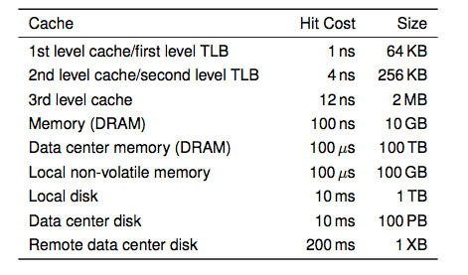
Memory Hierarchy
i7 has 8MB as shared 3rd level cache; 2nd level cache is per-core
Notes:
Anecdote: the system that I used for building my first OS, would fit in today’s 1st level cache

Slide 7
Main Points
Can we provide the illusion of near infinite memory in limited physical memory?
Demand-paged virtual memory
Memory-mapped files
How do we choose which page to replace?
FIFO, MIN, LRU, LFU, Clock

Slide 8
Hardware address translation is a power tool
Kernel trap on read/write to selected addresses
Copy on write
Fill on reference
Zero on use
Demand paged virtual memory
Memory mapped files
Modified bit emulation
Use bit emulation

Slide 9
Demand Paging
TLB miss
Page table walk
Page fault (page invalid in page table)
Trap to kernel
Convert virtual address to file + offset
Allocate page frame
Evict page if needed
Initiate disk block read into page frame
Disk interrupt when DMA complete
Mark page as valid
Resume process at faulting instruction
TLB miss
Page table walk to fetch translation
Execute instruction

Slide 10
Allocating a Page Frame
Select old page to evict
Find all page table entries that refer to old page
If page frame is shared
Set each page table entry to invalid
Remove any TLB entries
Copies of now invalid page table entry
Write changes on page back to disk, if necessary
Notes:
Why didn’t we need to shoot down the TLB before?

Slide 11
A Simple Policy
Random?
Replace a random entry
FIFO?
Replace the entry that has been in the cache the longest time
What could go wrong?

Slide 12
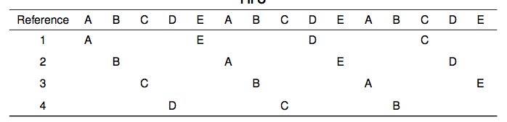
FIFO in Action
Worst case for FIFO is if program strides through memory that is larger than the cache

Slide 13
MIN, LRU, LFU
MIN
Replace the cache entry that will not be used for the longest time into the future
Optimality proof based on exchange: if evict an entry used sooner, that will trigger an earlier cache miss
Least Recently Used (LRU)
Replace the cache entry that has not been used for the longest time in the past
Approximation of MIN
Least Frequently Used (LFU)
Replace the cache entry used the least often (in the recent past)

Slide 14
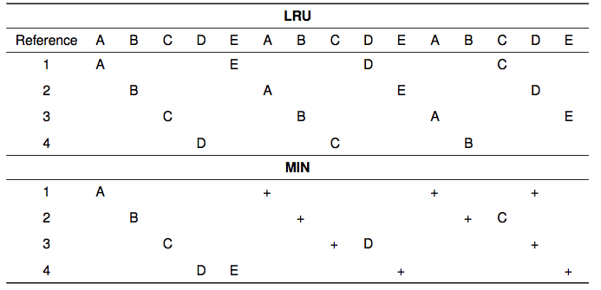
LRU/MIN for Sequential Scan

Slide 15
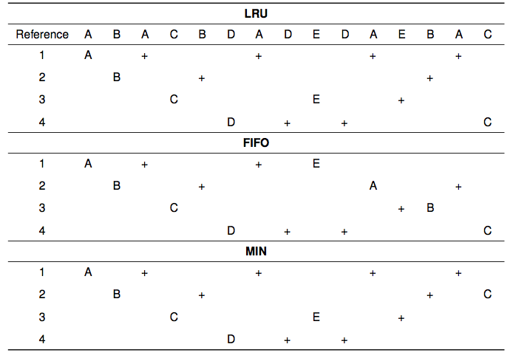
Notes:
For a reference pattern that exhibits locality

Slide 16
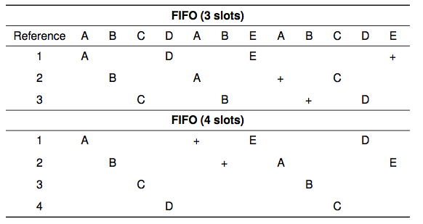
Belady’s Anomaly

Slide 17
Clock Algorithm: Estimating LRU
Periodically, sweep through all pages
If page is unused, reclaim
If page is used, mark as unused

Slide 18
Nth Chance: Not Recently Used
Instead of one bit per page, keep an integer
notInUseSince: number of sweeps since last use
Periodically sweep through all page frames
if (page is used) {
notInUseSince = 0;
} else if (notInUseSince < N) {
notInUseSince++;
} else {
reclaim page;
}

Slide 19
Demand Paging (Before)

Slide 20
Demand Paging (After)

Slide 21
Implementation Note
Clock and Nth Chance can run synchronously
In page fault handler, run algorithm to find next page to evict
Might require writing changes back to disk first
Or asynchronously
Create a thread to maintain a pool of recently unused, clean pages
Find recently unused dirty pages, write mods back to disk
Find recently unused clean pages, mark as invalid and move to pool
On page fault, check if requested page is in pool!
If not, evict that page

Slide 22
Recap
MIN is optimal
replace the page or cache entry that will be used farthest into the future
LRU is an approximation of MIN
For programs that exhibit spatial and temporal locality
Clock/Nth Chance is an approximation of LRU
Bin pages into sets of “not recently used”

Slide 23
Working Set Model
Working Set: set of memory locations that need to be cached for reasonable cache hit rate
Thrashing: when system has too small a cache

Slide 24
How do we know if page has been modified?
Every page table entry has some bookkeeping
Has page been modified?
Set by hardware on store instruction
In both TLB and page table entry
Has page been recently used?
Set by hardware on in page table entry on every TLB miss
Bookkeeping bits can be reset by the OS kernel
When changes to page are flushed to disk
To track whether page is recently used

Slide 25
Keeping Track of Page Modifications (Before)

Slide 26
Keeping Track of Page Modifications (After)

Slide 27
Virtual or Physical Dirty/Use Bits
Most machines keep dirty/use bits in the page table entry
Physical page is
Modified if any page table entry that points to it is modified
Recently used if any page table entry that points to it is recently used

Slide 28
Models for Application File I/O
Explicit read/write system calls
Data copied to user process using system call
Application operates on data
Data copied back to kernel using system call
Memory-mapped files
Open file as a memory segment
Program uses load/store instructions on segment memory, implicitly operating on the file
Page fault if portion of file is not yet in memory
Kernel brings missing blocks into memory, restarts process

Slide 29
Advantages to Memory-mapped Files
Programming simplicity, esp for large files
Operate directly on file, instead of copy in/copy out
Zero-copy I/O
Data brought from disk directly into page frame
Pipelining
Process can start working before all the pages are populated
Interprocess communication
Shared memory segment vs. temporary file

Slide 30
From Memory-Mapped Files to Demand-Paged Virtual Memory
Every process segment backed by a file on disk
Code segment -> code portion of executable
Data, heap, stack segments -> temp files
Shared libraries -> code file and temp data file
Memory-mapped files -> memory-mapped files
When process ends, delete temp files
Unified memory management across file buffer and process memory

